Slide 1
Binary search trees

Slide 2
Outline
This topic covers binary search trees:
Abstract Sorted Lists
Background
Definition and examples
Implementation:
Front, back, insert, erase
Previous smaller and next larger objects
Finding the k^{th} object

Slide 3
Abstract Sorted Lists
6.1.1
Previously, we discussed Abstract Lists: the objects are explicitly linearly ordered by the programmer
We will now discuss the Abstract Sorted List:
The relation is based on an implicit linear ordering
Certain operations no longer make sense:
push_front and push_back are replaced by a generic insert

Slide 4
Abstract Sorted Lists
6.1.1
Queries that may be made about data stored in a Sorted List ADT include:
Finding the smallest and largest values
Finding the k^{th} largest value
Find the next larger and previous smaller objects of a given object which may or may not be in the container
Iterate through those objects that fall on an interval [a, b]

Slide 5
Implementation
6.1.1
If we implement an Abstract Sorted List using an array or a linked list, we will have operations which are O(n)
As an insertion could occur anywhere in a linked list or array, we must either traverse or copy, on average, O(n) objects

Slide 6
Background
6.1.2
Recall that with a binary tree, we can dictate an order on the two children
We will exploit this order:
Require all objects in the left sub-tree to be less than the object stored in the root node, and
Require all objects in the right sub-tree to be greater than the object in the root object

Slide 7
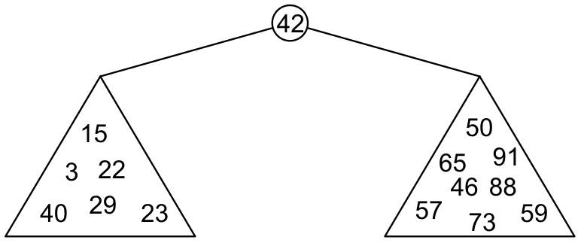
Binary Search Trees
6.1.2
Graphically, we may relationship
Each of the two sub-trees will themselves be binary search trees

Slide 8
Binary Search Trees
6.1.2
Notice that we can already use this structure for searching: examine the root node and if we have not found what we are looking for:
If the object is less than what is stored in the root node, continue searching in the left sub-tree
Otherwise, continue searching the right sub-tree
With a linear order, one of the following three must be true:
a < b a = b a > b

Slide 9
Definition
6.1.2
Thus, we define a non-empty binary search tree as a binary tree with the following properties:
The left sub-tree (if any) is a binary search tree and all values are less than the root value, and
The right sub-tree (if any) is a binary search tree and all values are greater than the root value

Slide 10
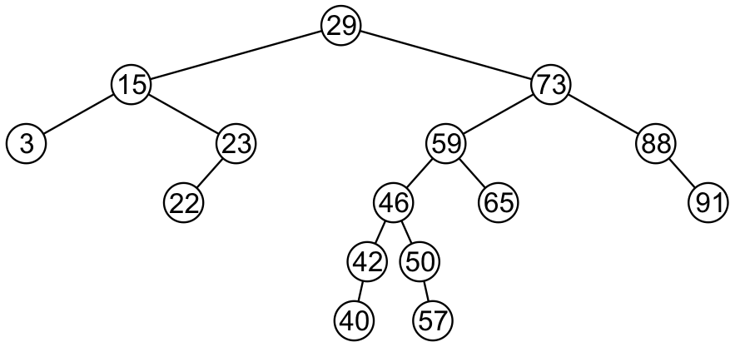
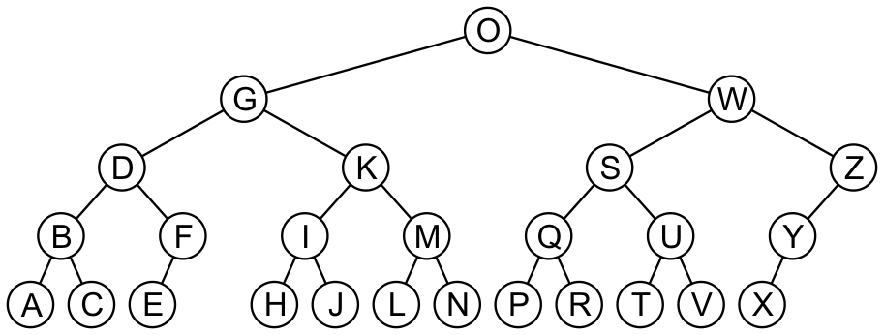
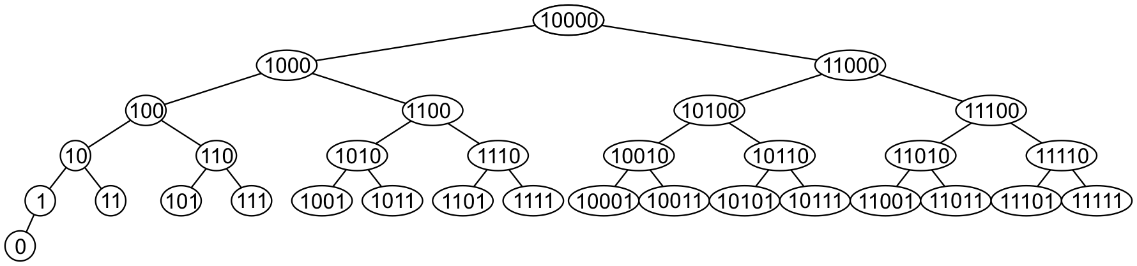
Examples
6.1.2
Here are other examples of binary search trees:

Slide 11
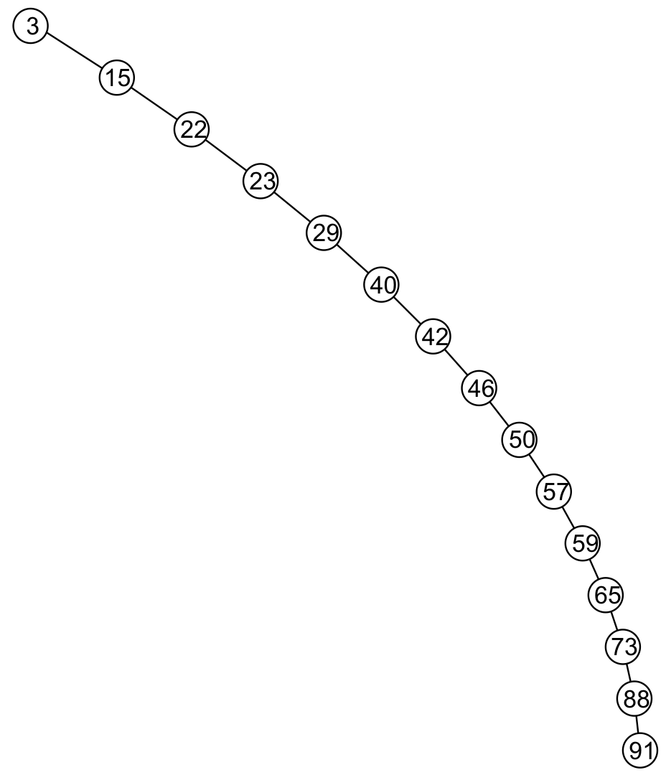
Examples
6.1.2
Unfortunately, it is possible to construct degenerate binary search trees
This is equivalent to a linked list, i.e., O(n)

Slide 12
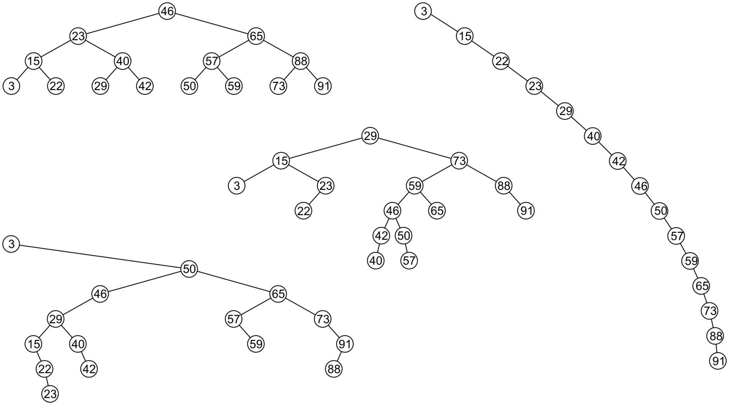
Examples
6.1.2
All these binary search trees store the same data

Slide 13
Duplicate values
6.1.3
We will assume that in any binary tree, we are not storing duplicate values unless otherwise stated
In reality, it is seldom the case where duplicate values in a container must be stored as separate entities
You can always consider duplicate values with modifications to the algorithms we will cover

Slide 14
Implementation
6.1.4
We will look at an implementation of a binary search tree in the same spirit as we did with our Single_list class
We will have a Binary_search_nodes class
A Binary_search_tree class will store a pointer to the root
We will use templates, however, we will require that the class overrides the comparison operators

Slide 15
Implementation
6.1.4
Any class which uses this binary-search-tree class must therefore implement:
bool operator<=( Type const &, Type const & );
bool operator< ( Type const &, Type const & );
bool operator==( Type const &, Type const & );
That is, we are allowed to compare two instances of this class
Examples: int and double

Slide 16
Implementation
6.1.4
#include "Binary_node.h"
template <typename Type>
class Binary_search_tree;
template <typename Type>
class Binary_search_node:public Binary_node<Type> {
using Binary_node<Type>::node_value;
using Binary_node<Type>::left_tree;
using Binary_node<Type>::right_tree;
public:
Binary_search_node( Type const & );
Binary_search_node *left() const;
Binary_search_node *right() const;

Slide 17
Implementation
6.1.4
Type front() const;
Type back() const;
bool find( Type const & ) const;
void clear();
bool insert( Type const & );
bool erase( Type const &, Binary_search_node *& );
friend class Binary_search_tree<Type>;
};

Slide 18
Constructor
6.1.4
The constructor simply calls the constructor of the base class
Recall that it sets both left_tree and right_tree to nullptr
It assumes that this is a new leaf node
template <typename Type>
Binary_search_node<Type>::Binary_search_node( Type const &obj ):
Binary_node<Type>( obj ) {
// Just calls the constructor of the base class
}

Slide 19
Standard Accessors
6.1.4
Because it is a derived class, it already inherits the function:
Type value() const;
Because the base class returns a pointer to a Binary_node, we must recast them as Binary_search_node:
template <typename Type>
Binary_search_node<Type> *Binary_search_node<Type>::left() const {
return reinterpret_cast<Binary_search_node *>( Binary_node<Type>::left() );
}
template <typename Type>
Binary_search_node<Type> *Binary_search_node<Type>::right() const {
return reinterpret_cast<Binary_search_node *>( Binary_node<Type>::right() );
}

Slide 20
Inherited Member Functions
6.1.4
The member functions
bool empty() const
bool is_leaf() const
int size() const
int height() const
are inherited from the bas class Binary_node

Slide 21
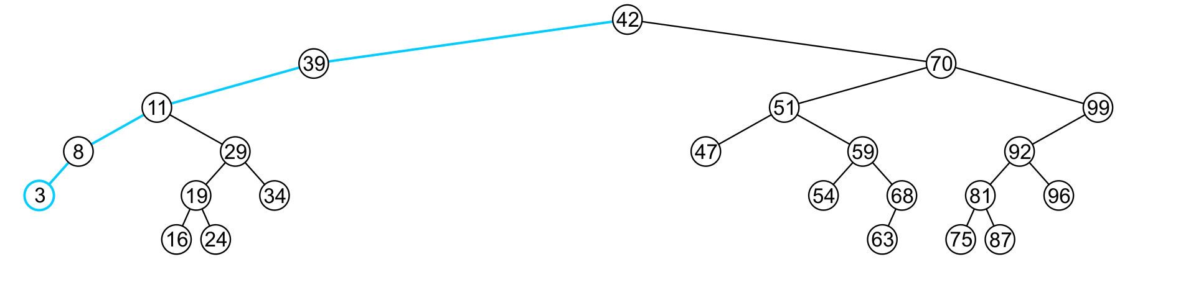
Finding the Minimum Object
6.1.4.1
template <typename Type>
Type Binary_search_node<Type>::front() const {
if ( empty() ) {
throw underflow();
}
return ( left()->empty() ) ? value() : left()->front();
}
The run time O(h)

Slide 22
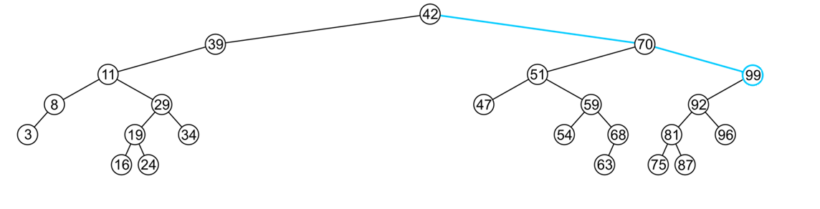
Finding the Maximum Object
6.1.4.2
template <typename Type>
Type Binary_search_node<Type>::back() const {
if ( empty() ) {
throw underflow();
}
return ( right()->empty() ) ? value() : right()->back();
}
The extreme values are not necessarily leaf nodes
Notes:
22

Slide 23
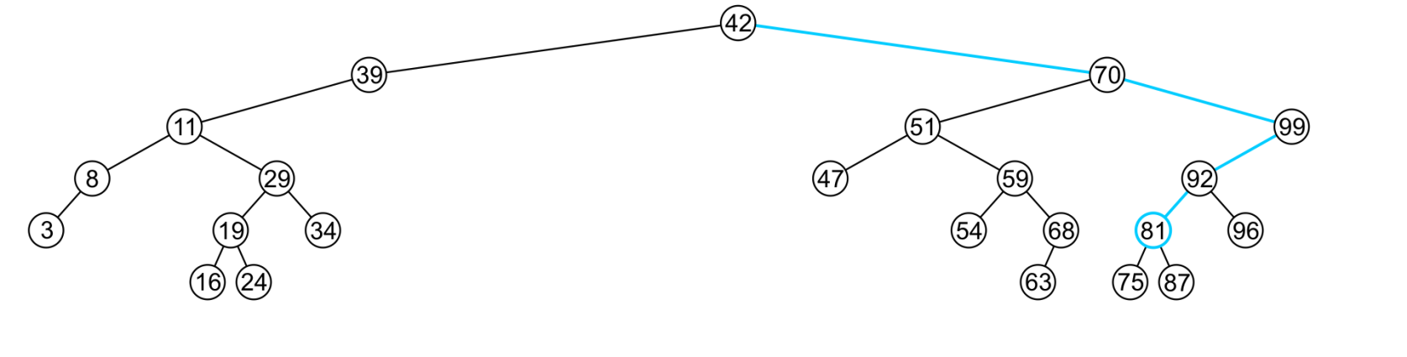
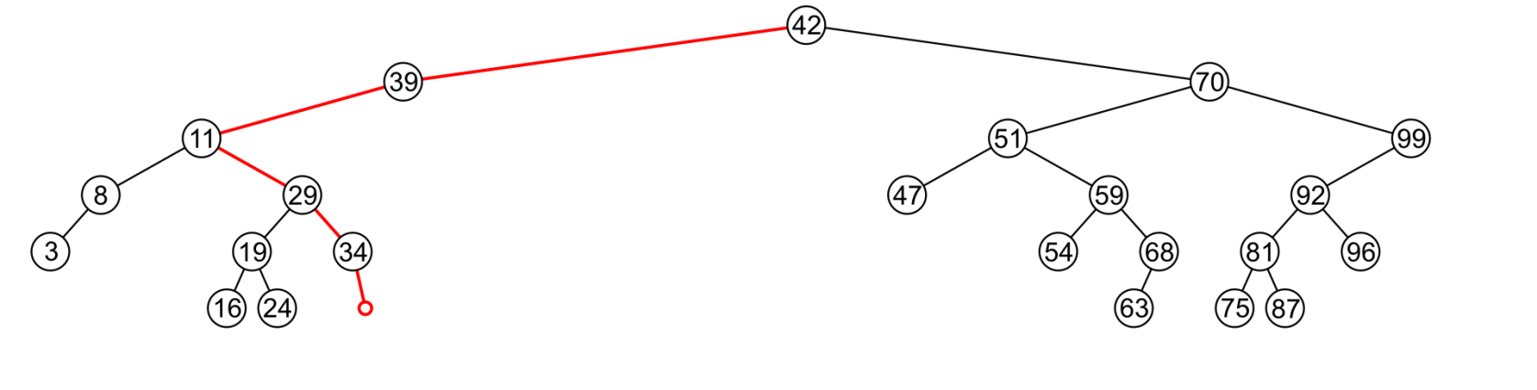
Find
6.1.4.3
To determine membership, traverse the tree based on the linear relationship:
If a node containing the value is found, e.g., 81, return 1
If an empty node is reached, e.g., 36, the object is not in the tree:

Slide 24
Find
6.1.4.3
The implementation is similar to front and back:
template <typename Type>
bool Binary_search_node<Type>::find( Type const &obj ) const {
if ( empty() ) {
return false;
} else if ( value() == obj ) {
return true;
}
return ( obj < value() ) ?
left()->find( obj ) : right()->find( obj );
}
The run time is O(h)
Notes:
24

Slide 25
Insert
6.1.4.4
Recall that a Sorted List is implicitly ordered
It does not make sense to have member functions such as push_front and push_back
Insertion will be performed by a single insert member function which places the object into the correct location

Slide 26
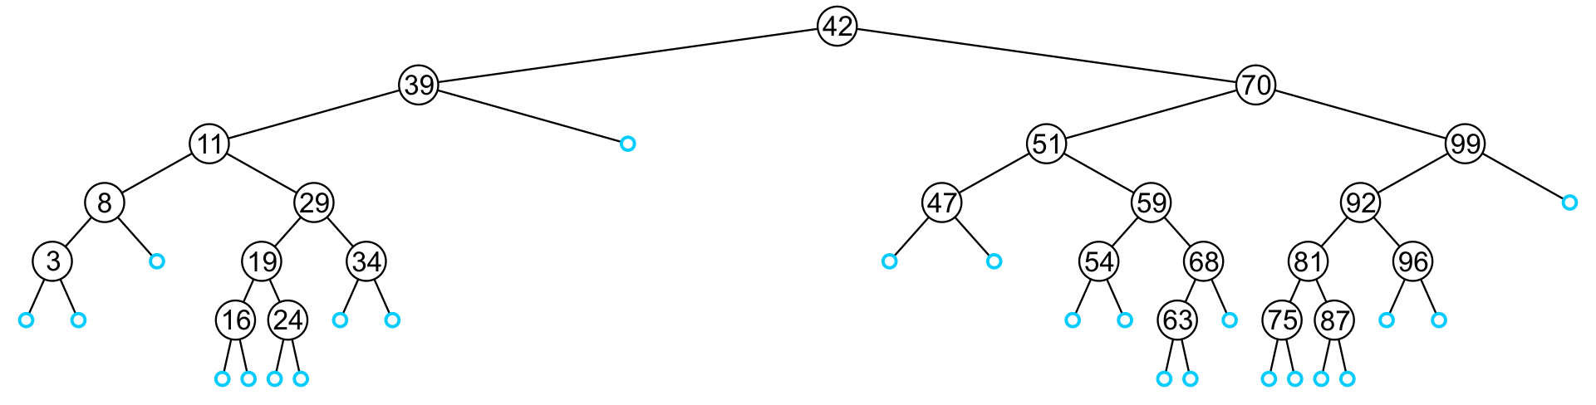
Insert
6.1.4.4
An insertion will be performed at a leaf node:
Any empty node is a possible location for an insertion
The values which may be inserted at any empty node depend on the surrounding nodes

Slide 27
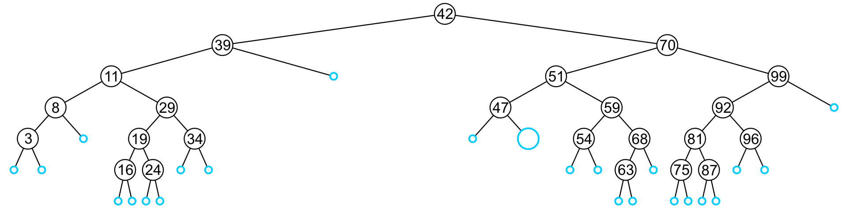
Insert
6.1.4.4
For example, this node may hold 48, 49, or 50

Slide 28
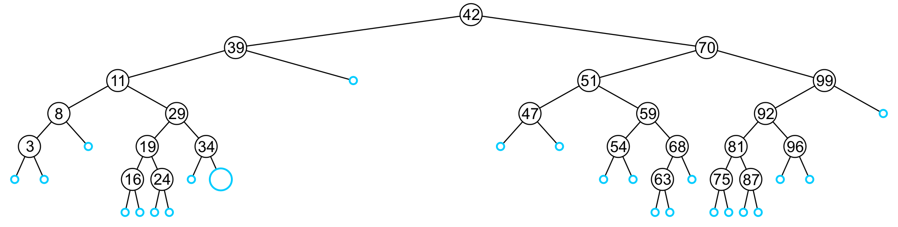
Insert
6.1.4.4
An insertion at this location must be 35, 36, 37, or 38

Slide 29
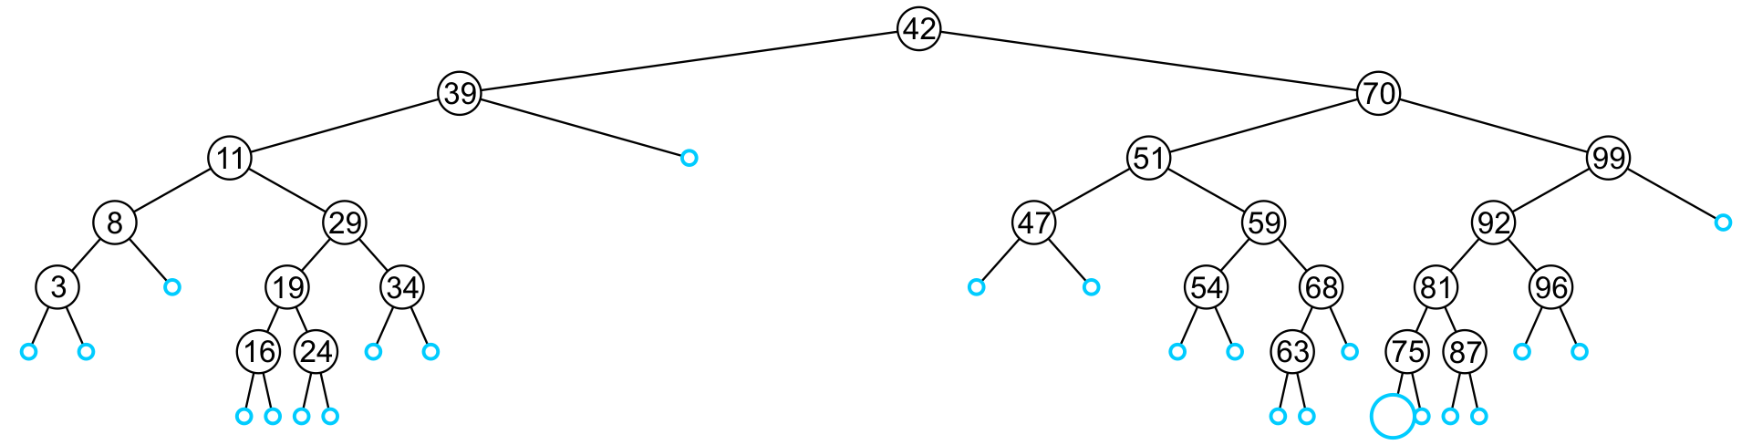
Insert
6.1.4.4
This empty node may hold values from 71 to 74

Slide 30
Insert
6.1.4.4
Like find, we will step through the tree
If we find the object already in the tree, we will return
The object is already in the binary search tree (no duplicates)
Otherwise, we will arrive at an empty node
The object will be inserted into that location
The run time is O(h)

Slide 31
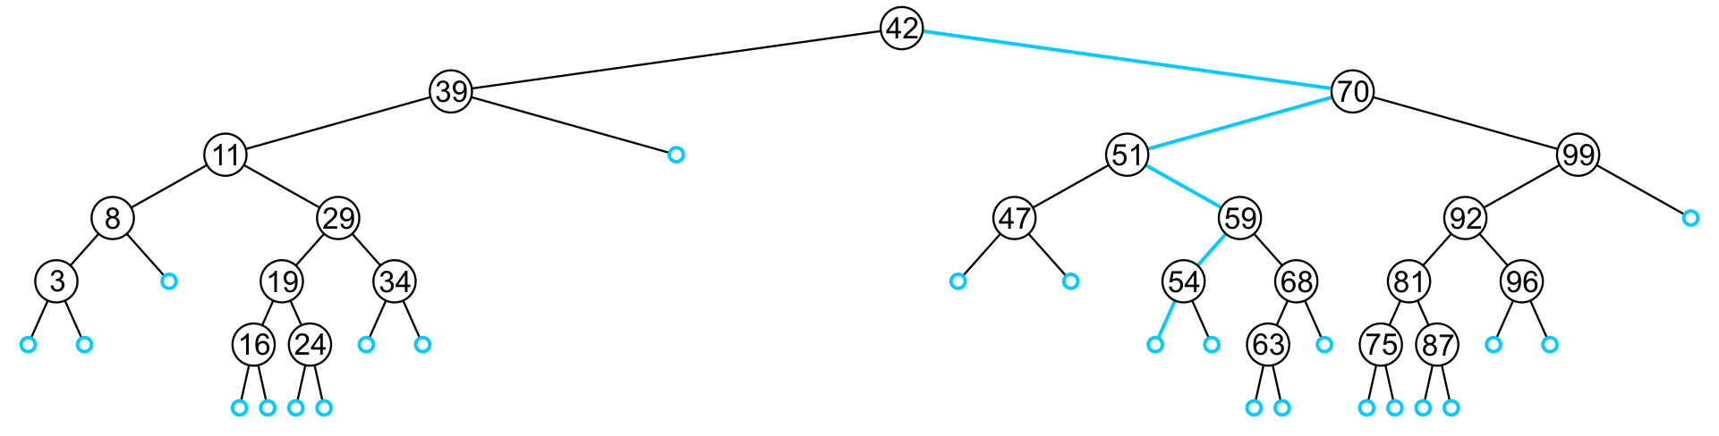
Insert
6.1.4.4
In inserting the value 52, we traverse the tree until we reach an empty node
The left sub-tree of 54 is an empty node

Slide 32
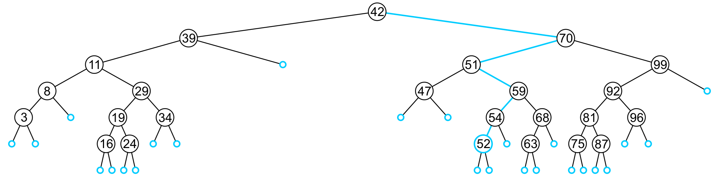
Insert
6.1.4.4
A new leaf node is created and assigned to the member variable left_tree

Slide 33
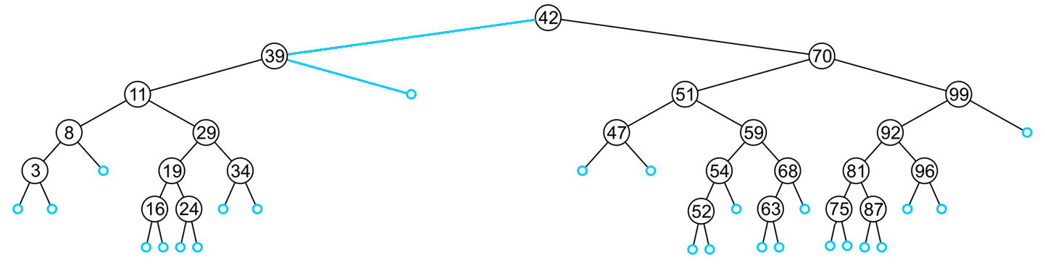
Insert
6.1.4.4
In inserting 40, we determine the right sub-tree of 39 is an empty node

Slide 34
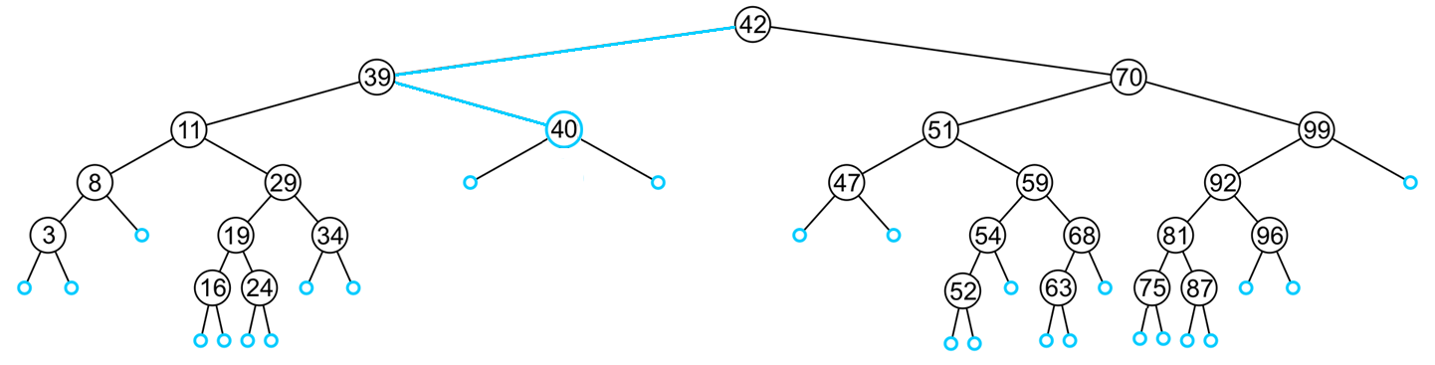
Insert
6.1.4.4
A new leaf node storing 40 is created and assigned to the member variable right_tree

Slide 35
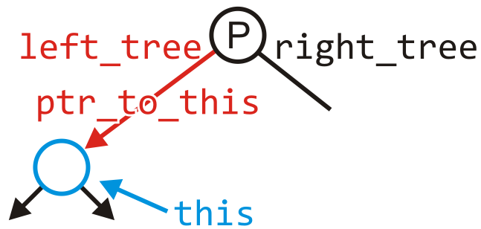
Insert
6.1.4.4
template <typename Type>
bool Binary_search_node<Type>::insert( Type const &obj,
Binary_search_node *&ptr_to_this ) {
if ( empty() ) {
ptr_to_this = new Binary_search_node<Type>( obj );
return true;
} else if ( obj < value() ) {
return left()->insert( obj, left_tree );
} else if ( obj > value() ) {
return right()->insert( obj, right_tree );
} else {
return false;
}
}

Slide 36
Insert
6.1.4.4
It is assumed that if neither of the conditions:
obj < value()
obj > value()
then obj == value() and therefore we do nothing
The object is already in the binary search tree

Slide 37
Insert
6.1.4.4
Blackboard example:
In the given order, insert these objects into an initially empty binary search tree:
31 45 36 14 52 42 6 21 73 47 26 37 33 8
What values could be placed:
To the left of 21?
To the right of 26?
To the left of 47?
How would we determine if 40 is in this binary search tree?
Which values could be inserted to increase the height of the tree?

Slide 38
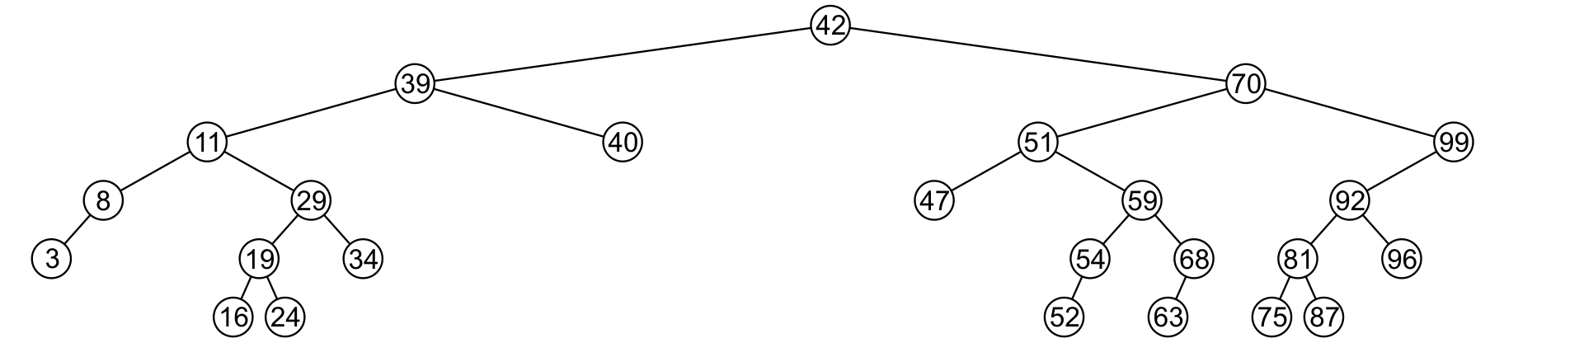
Erase
6.1.4.5
A node being erased is not always going to be a leaf node
There are three possible scenarios:
The node is a leaf node,
It has exactly one child, or
It has two children (it is a full node)

Slide 39
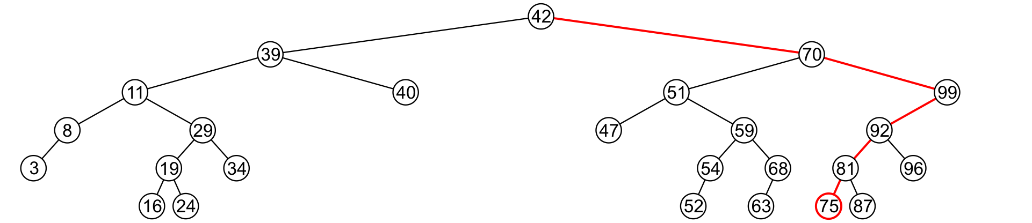
Erase
6.1.4.5
A leaf node simply must be removed and the appropriate member variable of the parent is set to nullptr
Consider removing 75

Slide 40
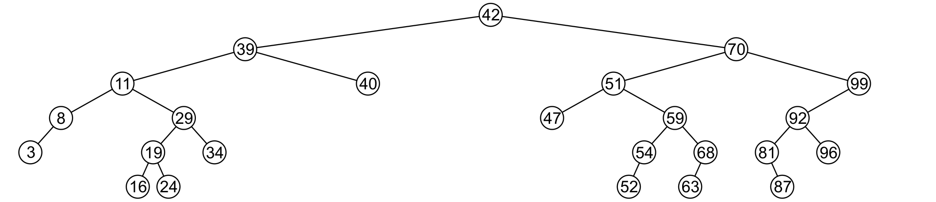
Erase
6.1.4.5
The node is deleted and left_tree of 81 is set to nullptr

Slide 41
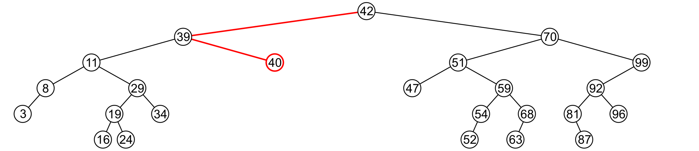
Erase
6.1.4.5
Erasing the node containing 40 is similar

Slide 42
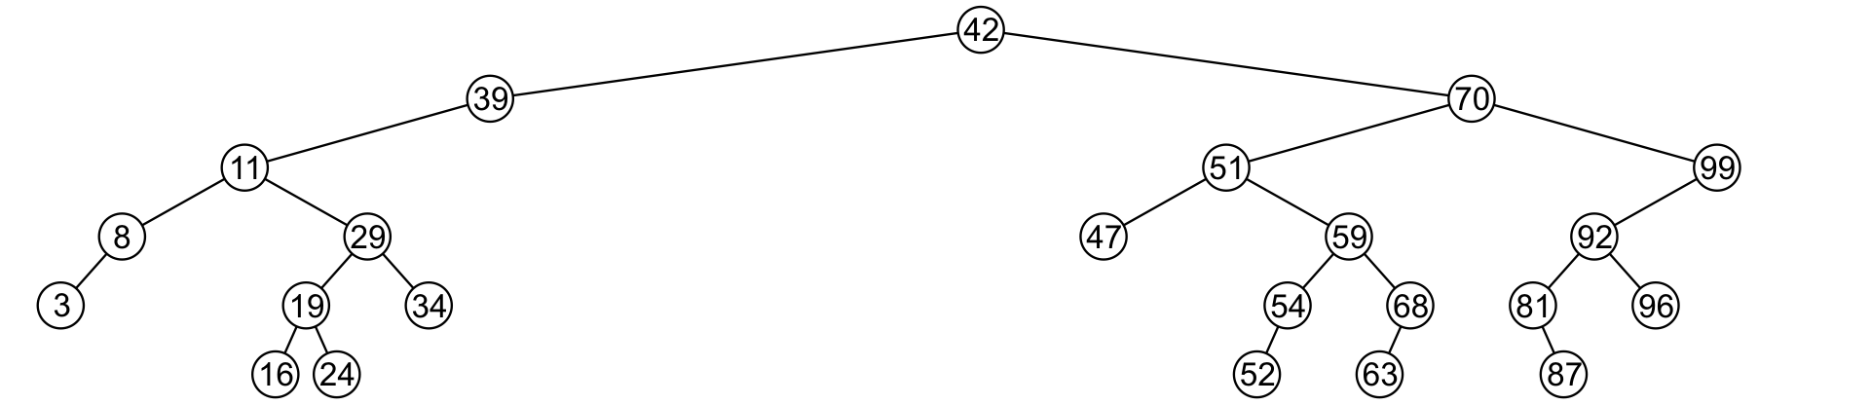
Erase
6.1.4.5
The node is deleted and right_tree of 39 is set to nullptr

Slide 43
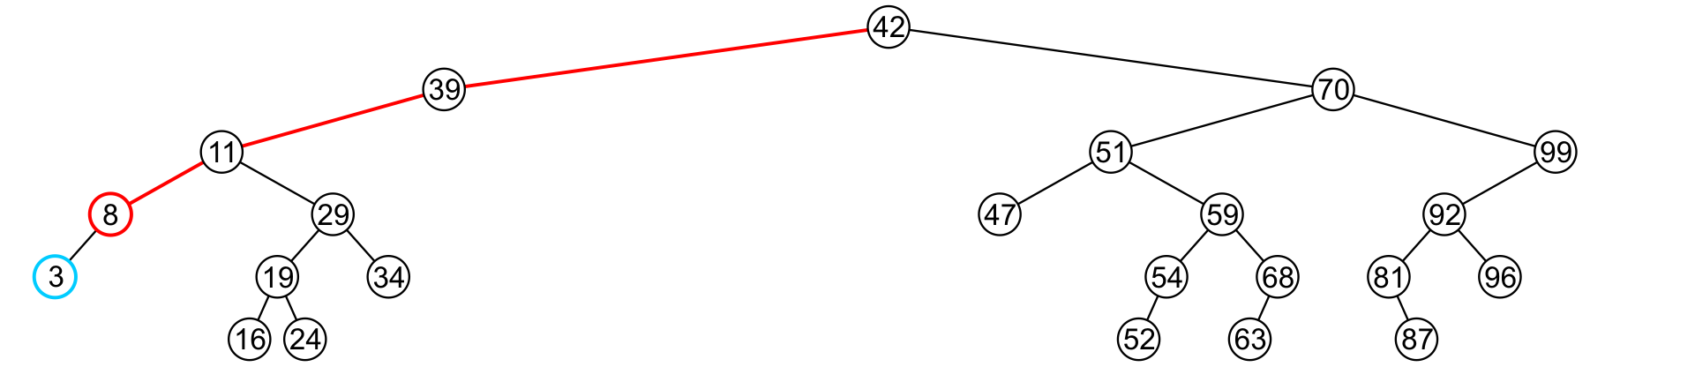
Erase
6.1.4.5
If a node has only one child, we can simply promote the sub-tree associated with the child
Consider removing 8 which has one left child

Slide 44
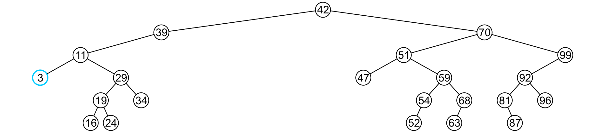
Erase
6.1.4.5
The node 8 is deleted and the left_tree of 11 is updated to point to 3

Slide 45
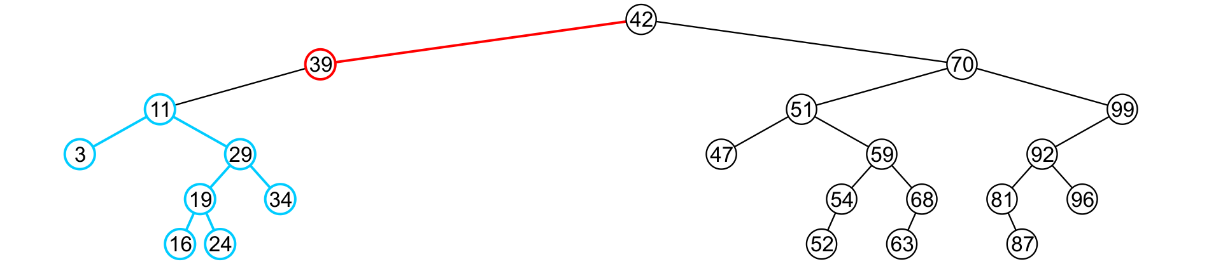
Erase
6.1.4.5
There is no difference in promoting a single node or a sub-tree
To remove 39, it has a single child 11

Slide 46
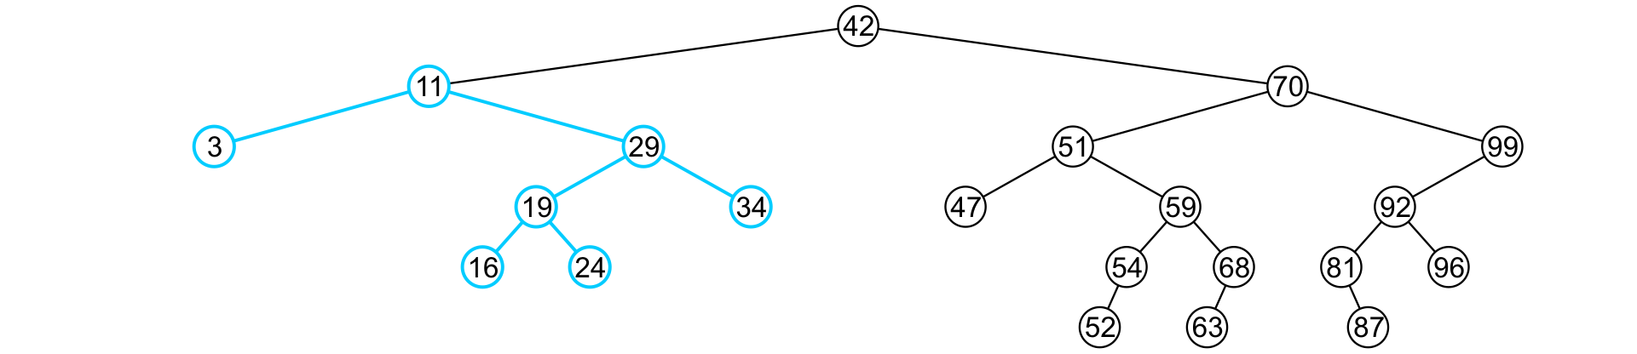
Erase
6.1.4.5
The node containing 39 is deleted and left_node of 42 is updated to point to 11
Notice that order is still maintained

Slide 47
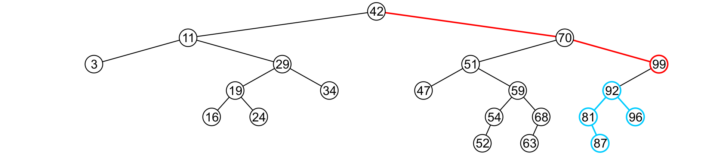
Erase
6.1.4.5
Consider erasing the node containing 99

Slide 48
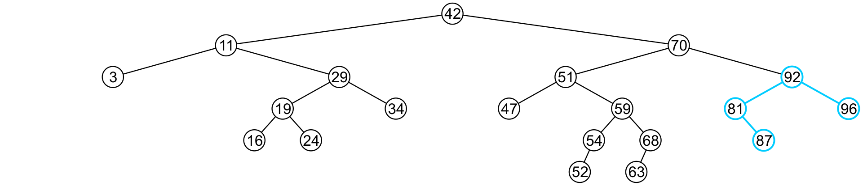
Erase
6.1.4.5
The node is deleted and the left sub-tree is promoted:
The member variable right_tree of 70 is set to point to 92
Again, the order of the tree is maintained

Slide 49
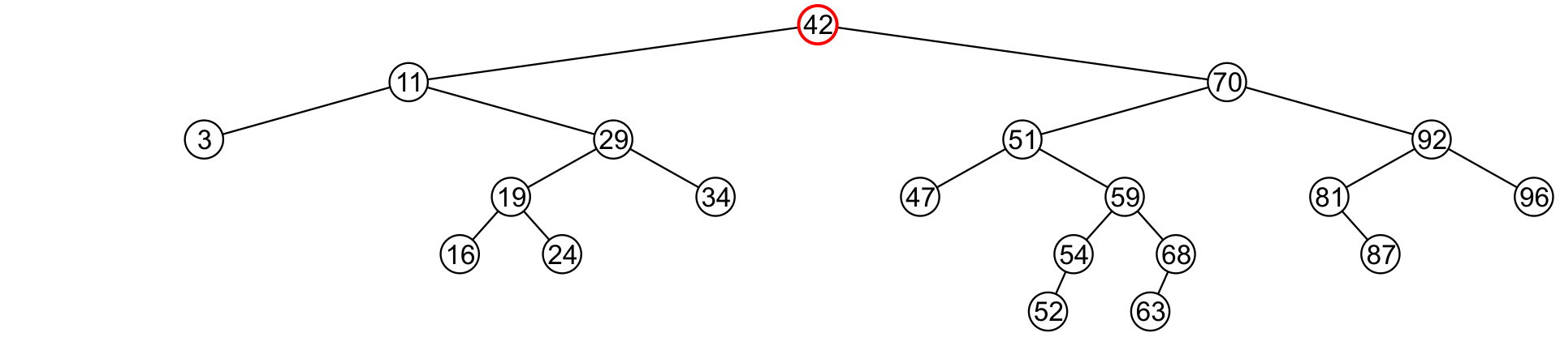
Erase
6.1.4.5
Finally, we will consider the problem of erasing a full node, e.g., 42
We will perform two operations:
Replace 42 with the minimum object in the right sub-tree
Erase that object from the right sub-tree

Slide 50
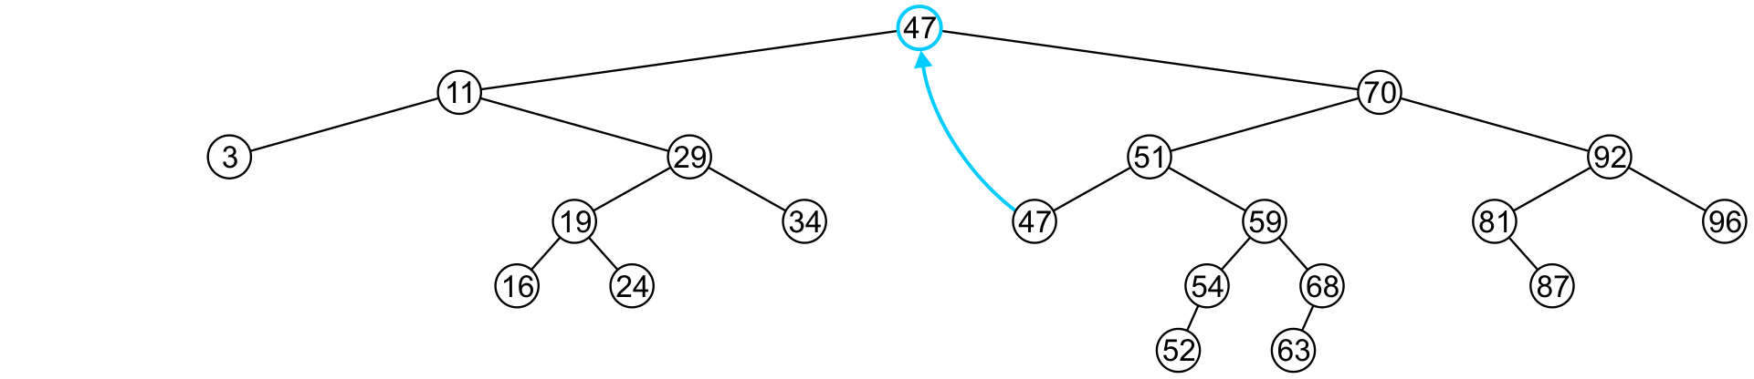
Erase
6.1.4.5
In this case, we replace 42 with 47
We temporarily have two copies of 47 in the tree

Slide 51
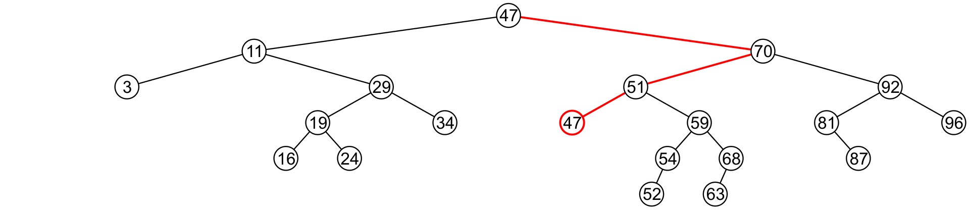
Erase
6.1.4.5
We now recursively erase 47 from the right sub-tree
We note that 47 is a leaf node in the right sub-tree

Slide 52
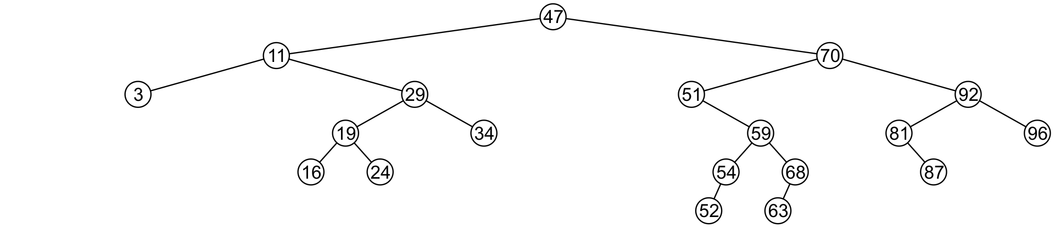
Erase
6.1.4.5
Leaf nodes are simply removed and left_tree of 51 is set to nullptr
Notice that the tree is still sorted:
47 was the least object in the right sub-tree

Slide 53
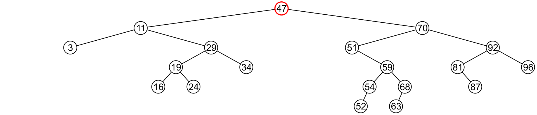
Erase
6.1.4.5
Suppose we want to erase the root 47 again:
We must copy the minimum of the right sub-tree
We could promote the maximum object in the left sub-tree and achieve similar results

Slide 54
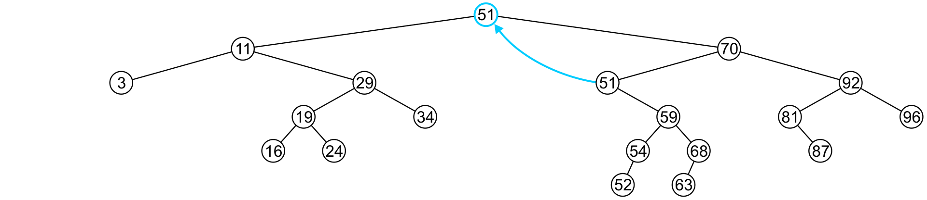
Erase
6.1.4.5
We copy 51 from the right sub-tree

Slide 55
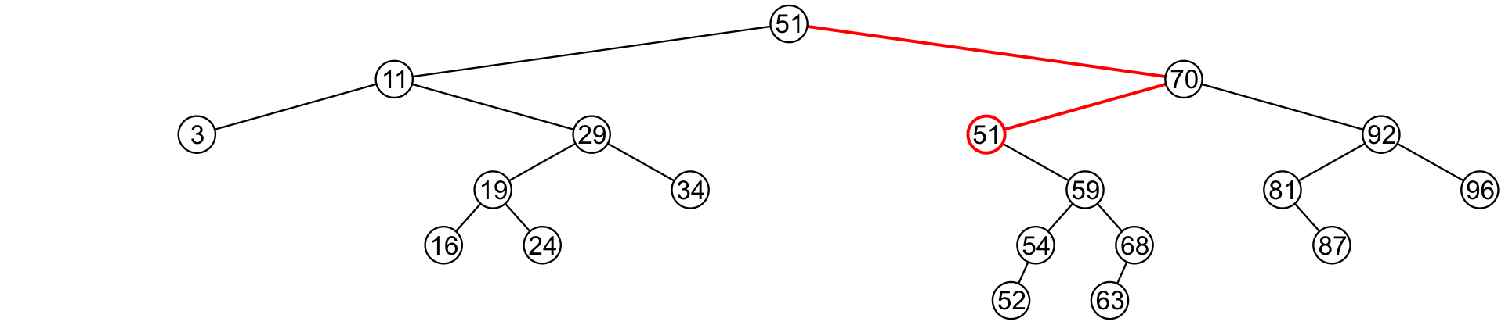
Erase
6.1.4.5
We must proceed by delete 51 from the right sub-tree

Slide 56
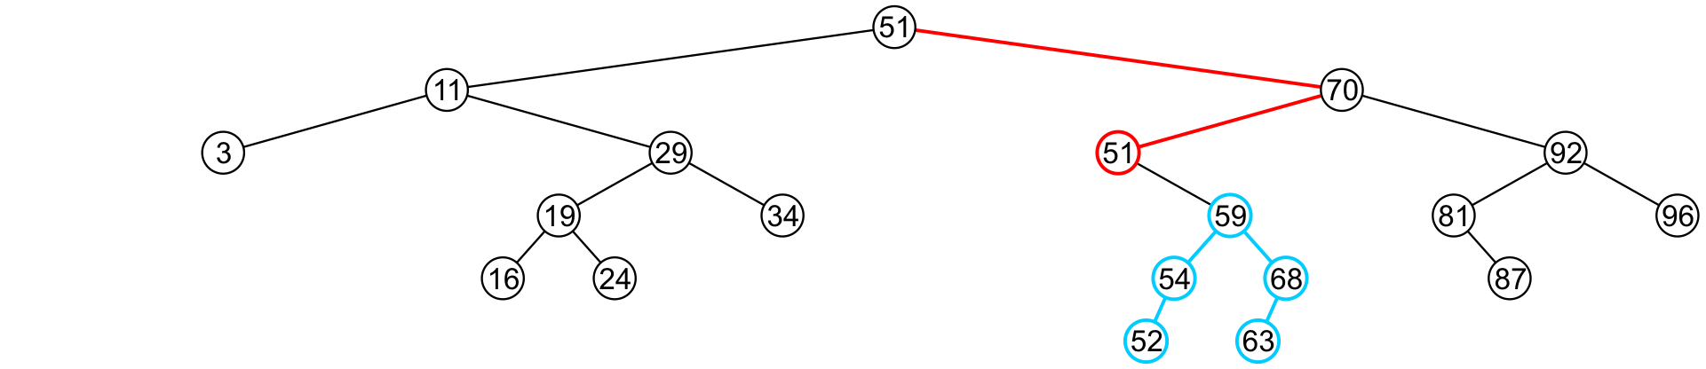
Erase
6.1.4.5
In this case, the node storing 51 has just a single child

Slide 57
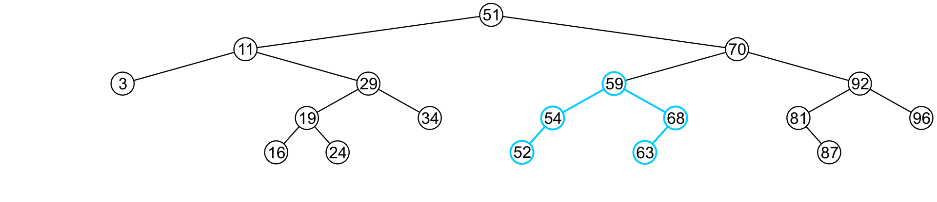
Erase
6.1.4.5
We delete the node containing 51 and assign the member variable left_tree of 70 to point to 59

Slide 58
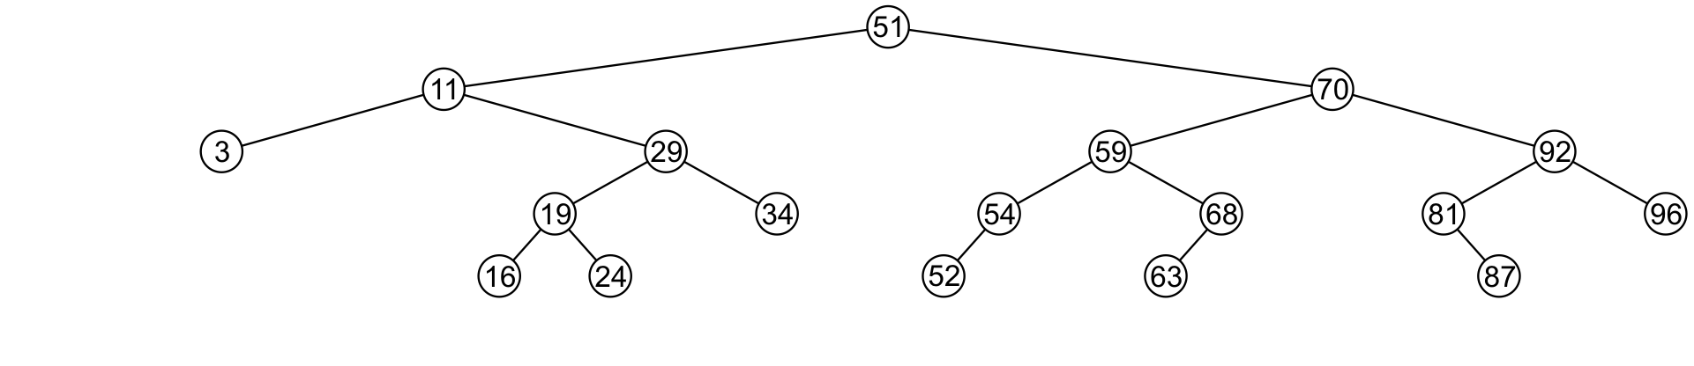
Erase
6.1.4.5
Note that after seven removals, the remaining tree is still correctly sorted

Slide 59


Erase
6.1.4.5
In the two examples of removing a full node, we promoted:
A node with no children
A node with right child
Is it possible, in removing a full node, to promote a child with two children?

Slide 60
Erase
6.1.4.5
Recall that we promoted the minimum value in the right sub-tree
If that node had a left sub-tree, that sub-tree would contain a smaller value

Slide 61
Erase
6.1.4.5
In order to properly remove a node, we will have to change the member variable pointing to the node
To do this, we will pass that member variable by reference
Additionally: We will return 1 if the object is removed and 1 if the object was not found

Slide 62
Erase
6.1.4.5
template <typename Type>
bool Binary_search_node<Type>::erase( Type const &obj, Binary_search_node *&ptr_to_this ) {
if ( empty() ) {
return false;
} else if ( obj == value() ) {
if ( is_leaf() ) { // leaf node
ptr_to_this = nullptr;
delete this;
} else if ( !left()->empty() && !right()->empty() ) { // full node
node_value = right()->front();
right()->erase( value(), right_tree );
} else { // only one child
ptr_to_this = ( !left()->empty() ) ? left() : right();
delete this;
}
return true;
} else if ( obj < value() ) {
return left()->erase( obj, left_tree ); } else {
return right()->erase( obj, right_tree ); }
}

Slide 63
Erase
6.1.4.5
Blackboard example:
In the binary search tree generated previously:
Erase 47
Erase 21
Erase 45
Erase 31
Erase 36

Slide 64
Binary Search Tree
6.1.5
We have defined binary search nodes
Similar to the Single_node in Project 1
We must now introduce a container which stores the root
A Binary_search_tree class
Most operations will be simply passed to the root node

Slide 65
Implementation
6.1.5
template <typename Type>
class Binary_search_tree {
private:
Binary_search_node<Type> *root_node;
Binary_search_node<Type> *root() const;
public:
Binary_search_tree();
~Binary_search_tree();
bool empty() const;
int size() const;
int height() const;
Type front() const;
Type back() const;
int count( Type const &obj ) const;
void clear();
bool insert( Type const &obj );
bool erase( Type const &obj );
};

Slide 66
Constructor, Destructor, and Clear
6.1.5
template <typename Type>
Binary_search_tree<Type>::Binary_search_tree():
root_node( nullptr ) {
// does nothing
}
template <typename Type>
Binary_search_tree<Type>::~Binary_search_tree() {
clear();
}
template <typename Type>
void Binary_search_tree<Type>::clear() {
root()->clear( root_node );
}

Slide 67
Constructor, Destructor, and Clear
6.1.5
template <typename Type>
Binary_search_tree<Type> *Binary_search_tree<Type>::root() const {
return tree_root;
}
template <typename Type>
bool Binary_search_tree<Type>::empty() const {
return root()->empty();
}
template <typename Type>
int Binary_search_tree<Type>::size() const {
return root()->size();
}

Slide 68
Empty, Size, Height and Count
6.1.5
template <typename Type>
int Binary_search_tree<Type>::height() const {
return root()->height();
}
template <typename Type>
bool Binary_search_tree<Type>::find( Type const &obj ) const {
return root()->find( obj );
}

Slide 69
Front and Back
6.1.5
// If root() is nullptr, 'front' will throw an underflow exception
template <typename Type>
Type Binary_search_tree<Type>::front() const {
return root()->front();
}
// If root() is nullptr, 'back' will throw an underflow exception
template <typename Type>
Type Binary_search_tree<Type>::back() const {
return root()->back();
}

Slide 70
Insert and Erase
6.1.5
template <typename Type>
bool Binary_search_tree<Type>::insert( Type const &obj ) {
return root()->insert( obj, root_node );
}
template <typename Type>
bool Binary_search_tree<Type>::erase( Type const &obj ) {
return root()->erase( obj, root_node );
}

Slide 71
Other Relation-based Operations
6.1.6
We will quickly consider two other relation-based queries that are very quick to calculate with an array of sorted objects:
Finding the previous and next values, and
Finding the k^{th} value

Slide 72
Previous and Next Objects
6.1.6.1
All the operations up to now have been operations which work on any container: count, insert, etc.
If these are the only relevant operations, use a hash table
Operations specific to linearly ordered data include:
Find the next larger and previous smaller objects of a given object which may or may not be in the container
Find the k^{th} value of the container
Iterate through those objects that fall on an interval [a, b]
We will focus on finding the next largest object
The others will follow

Slide 73
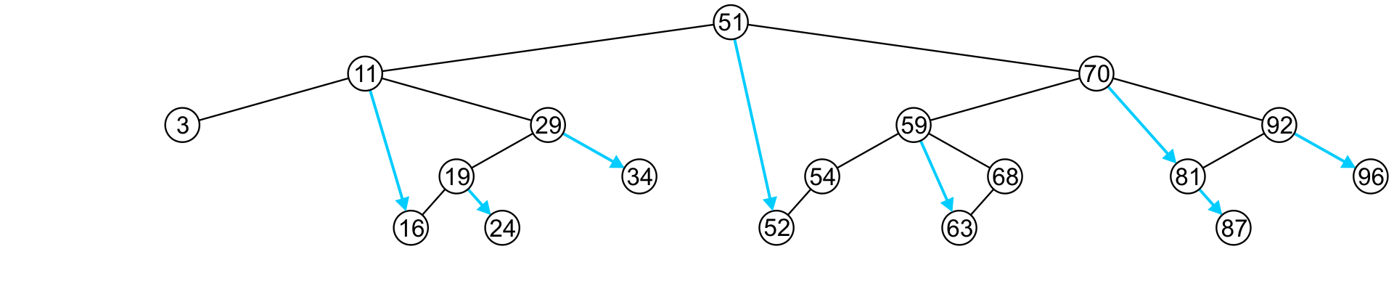
Previous and Next Objects
6.1.6.1
To find the next largest object:
If the node has a right sub-tree, the minimum object in that sub-tree is the next-largest object

Slide 74
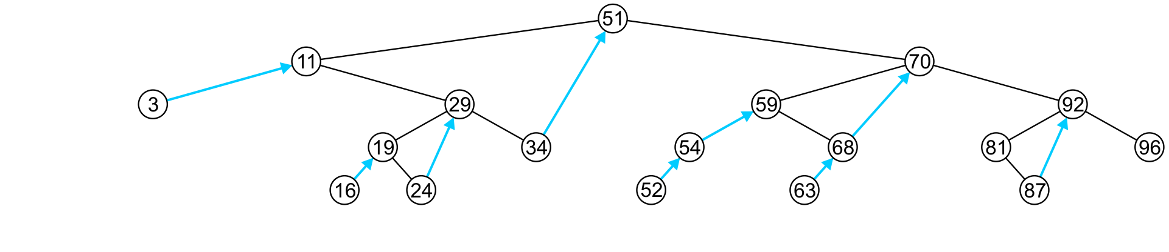
Previous and Next Objects
6.1.6.1
If, however, there is no right sub-tree:
It is the next largest object (if any) that exists in the path from the root to the node

Slide 75
Previous and Next Objects
6.1.6.1
More generally: what is the next largest value of an arbitrary object?
This can be found with a single search from the root node to one of the leaves—an O(h) operation
This function returns the object if it did not find something greater than it
template <typename Type>
Type Binary_search_node<Type>::next( Type const &obj ) const {
if ( empty() ) {
return obj;
} else if ( value() == obj ) {
return ( right()->empty() ) ? obj : right()->front();
} else if ( value() > obj ) {
Type tmp = left()->next( obj );
return ( tmp == obj ) ? value() : tmp;
} else {
return right()->next( obj );
}
}

Slide 76
Finding the k^{th} Object
6.1.6.2
Another operation on sorted lists may be finding the k^{th} largest object
Recall that k goes from 0 to n – 1
If the left-sub-tree has ℓ = k values, return the current node,
If the left sub-tree has ℓ < k values, return the k^{th} value of the left sub-tree,
Otherwise, the left sub-tree has ℓ > k values, so return the (k – ℓ – 1)^{th} value of the right sub-tree
18
7
10
1
5
0
1
2
3
4
5
6
7
8
9
10
11
12
13
14
15
16
17

Slide 77
Finding the k^{th} Object
6.1.6.2
template <typename Type>
Type Binary_search_tree<Type>::at( int k ) const {
return ( k < 0 || k >= size() ) ? Type() : root()->at( k );
// Need to go from 0, ..., n - 1
}
template <typename Type>
Type Binary_search_node<Type>::at( int k ) const {
if ( left()->size() == k ) {
return value();
} else if ( left()->size() > k ) {
return left()->at( k );
} else {
return right()->at( k - left()->size() – 1 );
}
}

Slide 78
Finding the k^{th} Object
6.1.7
This requires that size() returns in Θ(1) time
We must have a member variable
int tree_size;
which stores the number of descendants of this node
This requires Θ(n) additional memory
template <typename Type>
bool Binary_search_tree<Type>::size() const {
return root()->size();
}
We can implement this in the Binary_node class, if we want
The constructor will set the size to 1

Slide 79
Finding the k^{th} Object
6.1.7
We must now update insert(…) and erase(…) to update it
template <typename Type>
bool Binary_search_node<Type>::insert( Type const &obj,
Binary_search_node *&ptr_to_this ) {
if ( empty() ) {
ptr_to_this = new Binary_search_node<Type>( obj );
return true;
} else if ( obj < value() ) {
return left()->insert( obj, left_tree ) ? ++tree_size : false;
} else if ( obj > value() ) {
return right()->insert( obj, right_tree ) ? ++tree_size : false;
} else {
return false;
}
}
Clever trick: in C and C++, any non-zero value is interpreted as true

Slide 80
Run Time: O(h)
6.1.7
Almost all of the relevant operations on a binary search tree are O(h)
If the tree is close to a linked list, the run times is O(n)
Insert 1, 2, 3, 4, 5, 6, 7, ..., n into a empty binary search tree
The best we can do is if the tree is perfect: O(ln(n))
Our goal will be to find tree structures where we can maintain a height of Θ(ln(n))
We will look at
AVL trees
B+ trees
both of which ensure that the height remains Θ(ln(n))
Others exist, too

Slide 81
Summary
In this topic, we covered binary search trees
Described Abstract Sorted Lists
Problems using arrays and linked lists
Definition a binary search tree
Looked at the implementation of:
Empty, size, height, count
Front, back, insert, erase
Previous smaller and next larger objects

Slide 82
Usage Notes
These slides are made publicly available on the web for anyone to use
If you choose to use them, or a part thereof, for a course at another institution, I ask only three things:
that you inform me that you are using the slides,
that you acknowledge my work, and
that you alert me of any mistakes which I made or changes which you make, and allow me the option of incorporating such changes (with an acknowledgment) in my set of slides
Sincerely,
Douglas Wilhelm Harder, MMath
dwharder@alumni.uwaterloo.ca

